Slide 1
Introduction to Tableau
Part 11
Notes:
Welcome back to Data Society! We have a great class ahead of us today.

Slide 2
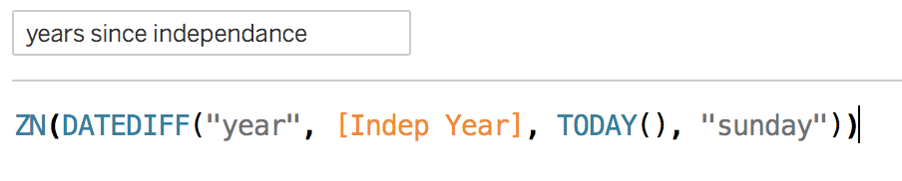
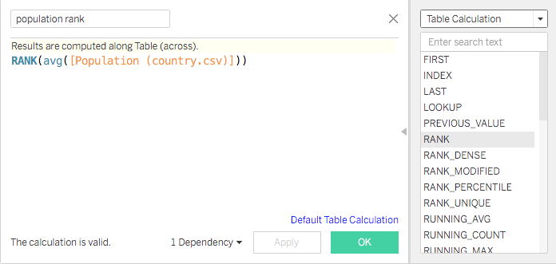
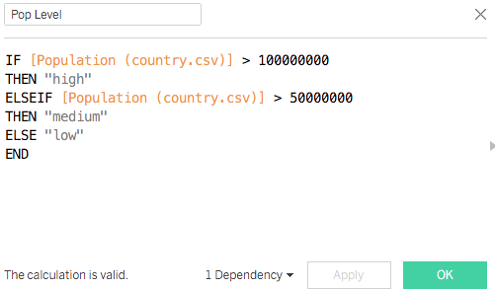
Recap: functions in Tableau
Number Functions
String Functions
Date Functions
Type Conversion
Logical Functions
Aggregate Functions
Table Calculation Functions
User Functions
Spatial Functions
Additional Functions
Notes:
The purpose of this slide is to recap the past couple of sessions, on functions in Tableau. REMIND students about the various uses of the functions in the first set. SUGGEST students read up on other categories of function as use-cases present themselves in their own work with data, especially in the categories in the second set (which we haven’t really covered).

Slide 3
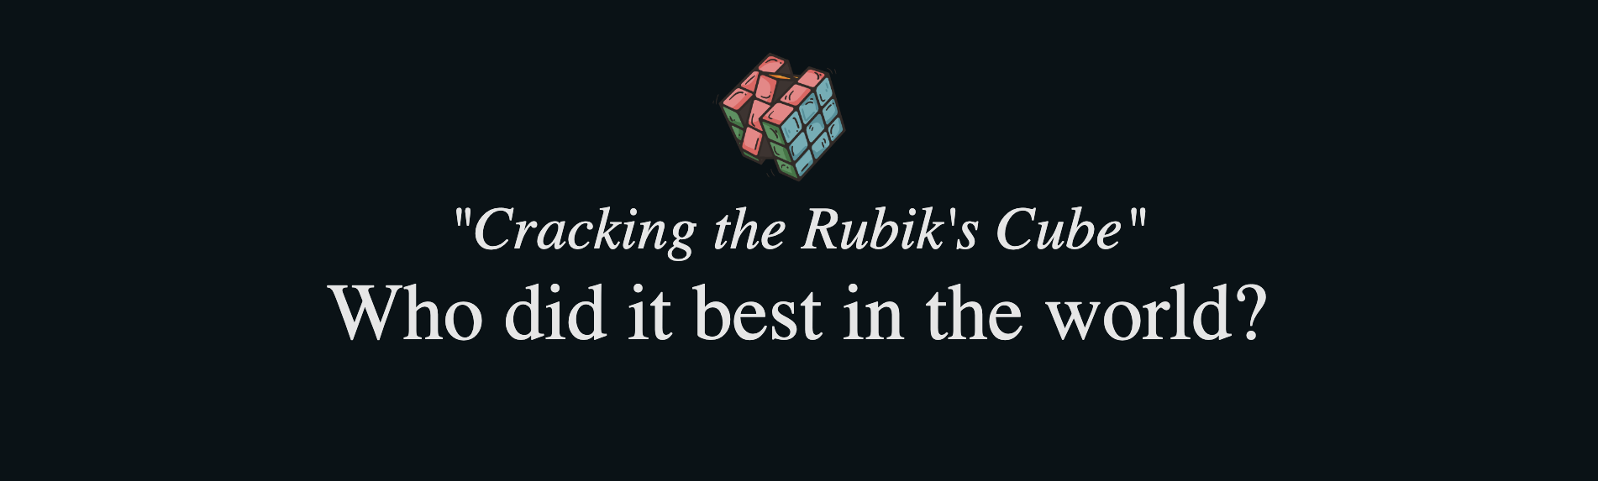
Warm-up: Tableau Public
Spend a few minutes exploring the Cracking the Rubik’s Cube dashboard from the Tableau Public Viz of the Day collection.
How many different ways do you see the dashboard leverage geospatial data?
Cracking the Rubik’s Cube dashboard (link)
Notes:
The purpose of this slide is to introduce a dashboard that spotlights geospatial data. ASK students the question on the slide, then COMMENT on responses. You may also want to COMMENT on some of the choices that have been made:
Optional additional questions:
How could the geospatial visualization be improved?

Slide 4
Module completion checklist
Objective | Complete
Introduce the concept of geospatial visualization
Implement geospatial visualization for given dataset
Identify and correct errors to facilitate proper joining with geospatial data
Introduce the concept of Dashboards
Combine previously created visualizations into Dashboard

Slide 5

Why is mapping useful?
Spatial data is a prevalent data type, and can be especially useful with financial and economic data.
Visualizing spatial data can uncover interaction between economic variables and geographic locations.
Can you think of any such interactions with data you work with?
Notes:
The purpose of this slide is to introduce the value of mapping, i.e. visually representing spatial data.

Slide 6
Mapping in Tableau
Geospatial visualization is one of the most compelling uses for Tableau.
Tableau makes mapping convenient by offering ready-made map types and plugins.
Custom mapping capacity
Makes mapping custom regions possible.
Allows custom backgrounds and coordinates.
You could map spots on the sun or annotate regions of the brain.
Tableau mapping can be extended through connections to more advanced tools, like Mapbox.
Notes:
The purpose of this slide is to discuss the advantages of visualizing geospatial data in Tableau.

Slide 7
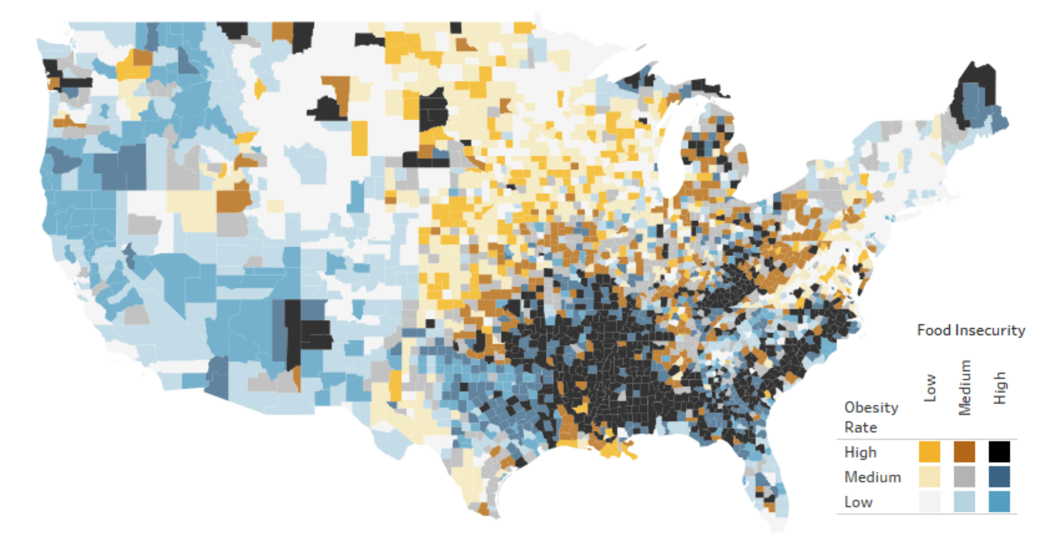
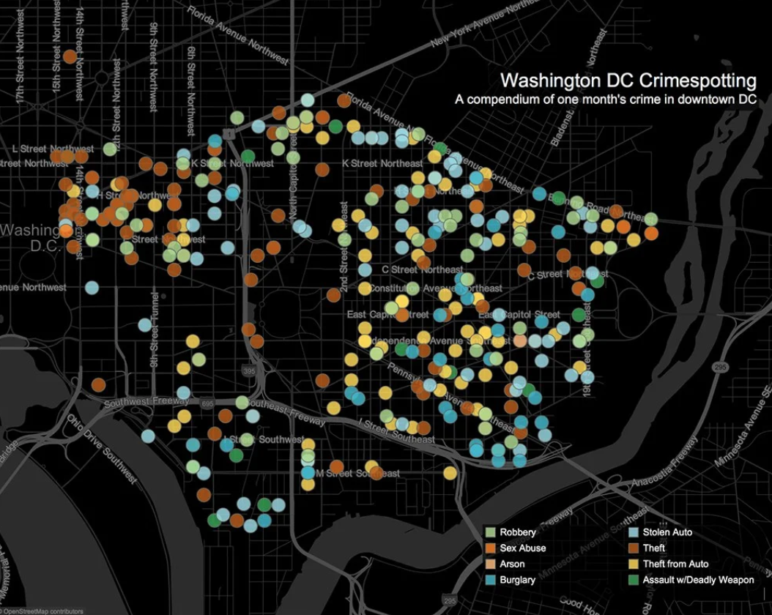
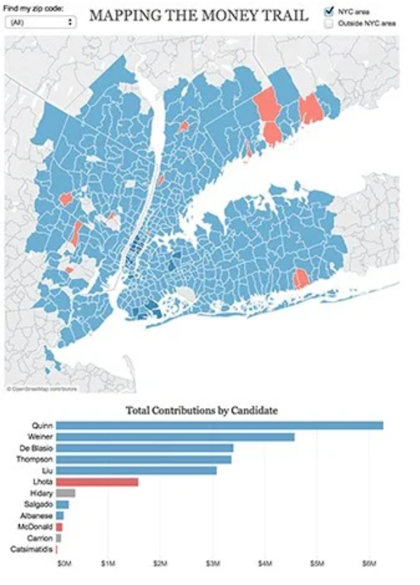
Geospatial visualization
Some examples of where one would use maps include:
Obesity rates plotted across the US.
Crime events in Washington DC.
Campaign contributions by district in NYC.
You can see more examples of Tableau maps (link).
Notes:
The purpose of this slide is to provide some possible use-cases for geospatial visualization. RECOMMEND students spend some time perusing the gallery of chloropleth maps at the following link: https://www.tableau.com/about/blog/2018/2/how-make-effective-bivariate-choropleth-maps-tableau-83121
Feel free to showcase additional mapping projects via the Tableau gallery: https://public.tableau.com/en-us/gallery

Slide 8

Automatic coordinate generation
Tableau automatically recognizes data that naturally has coordinates, like countries, cities, counties, etc.
For these data it automatically generates longitude and latitude coordinates as measures.
Notes:
The purpose of this slide is to point out how Tableau attempts to generate lat/long coordinates for geospatial data. POINT OUT that, as with its other auto-fill features, there’s often some work to do to clean the data and fill in missing values.

Slide 9
Reminder: save your work!
In the next few modules, we will be creating more elaborate visualizations.
We will see a lot of different insights from the data as we learn more in Tableau.
Make sure to save all your classwork (including Exercises), because we will be putting it all together at the end of the unit to create a story.
Notes:
The purpose of this slide is to remind students to save their work.

Slide 10
Module completion checklist
Objective | Complete
Introduce the concept of geospatial visualization
Implement geospatial visualization for given dataset
Identify and correct errors to facilitate proper joining with geospatial data
Introduce the concept of Dashboards
Combine previously created visualizations into Dashboard

Slide 11
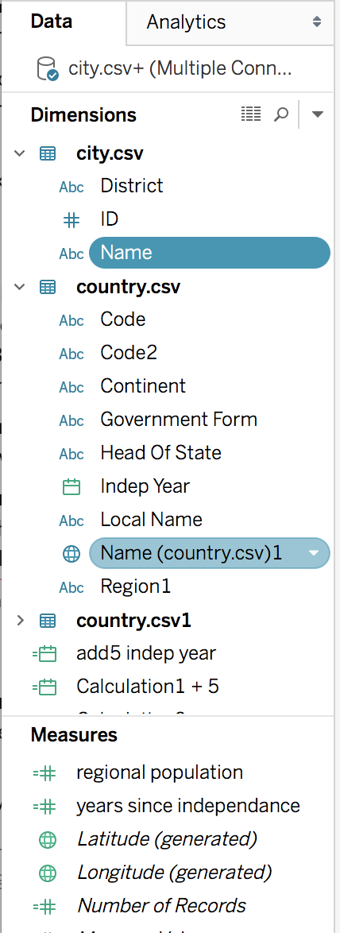
Generating automatic coordinates
Let’s implement Tableau’s mapping function using our world dataset.
Notice that “Name(country.csv)1” in the country table has been assigned coordinates.
The globe indicates geospatial data.
Note that other geospatial dimensions such as “City” were not recognized.
We will fix this later in the class.
Notes:
The purpose of this slide is to show how to recognize for which dimensions Tableau has automatically generated geospatial data.

Slide 12
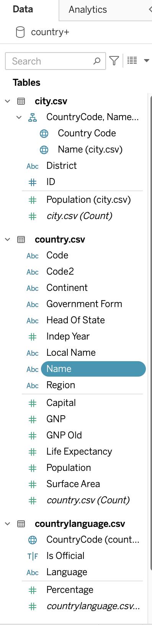
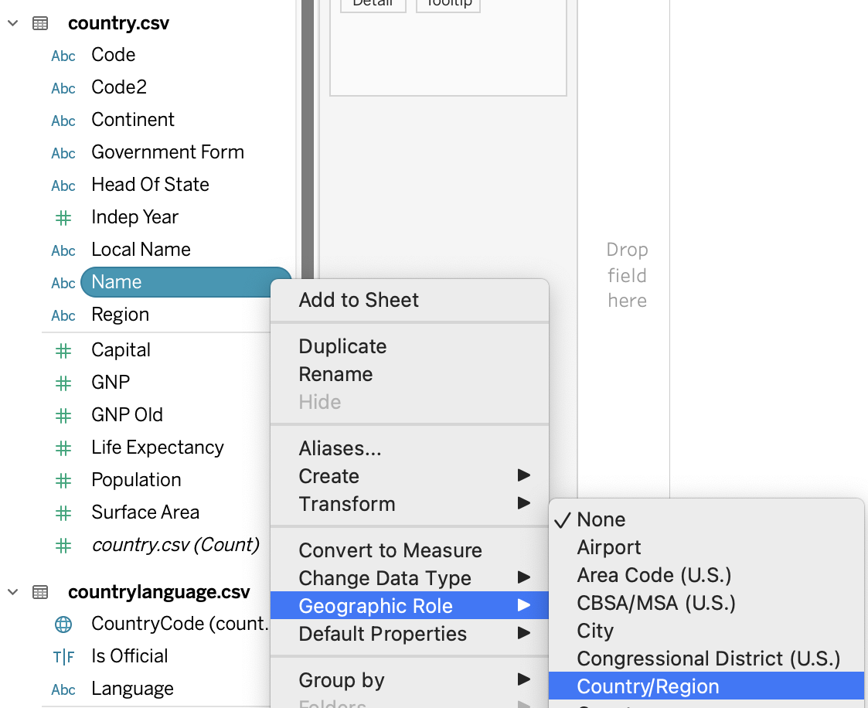
Manually converting to geospatial data
Note that Tableau didn’t recognize some of our geospatial data, like for “Name(country.csv)”
To fix this, use the dropdown from the pill and tell Tableau which type of geospatial coordinates we have.
In this case we have to tell Tableau that this “Name” is country data.
Notes:
The purpose of this slide is to how to manually specify a certain data dimension (in this case, Country Name) as geospatial data.

Slide 13
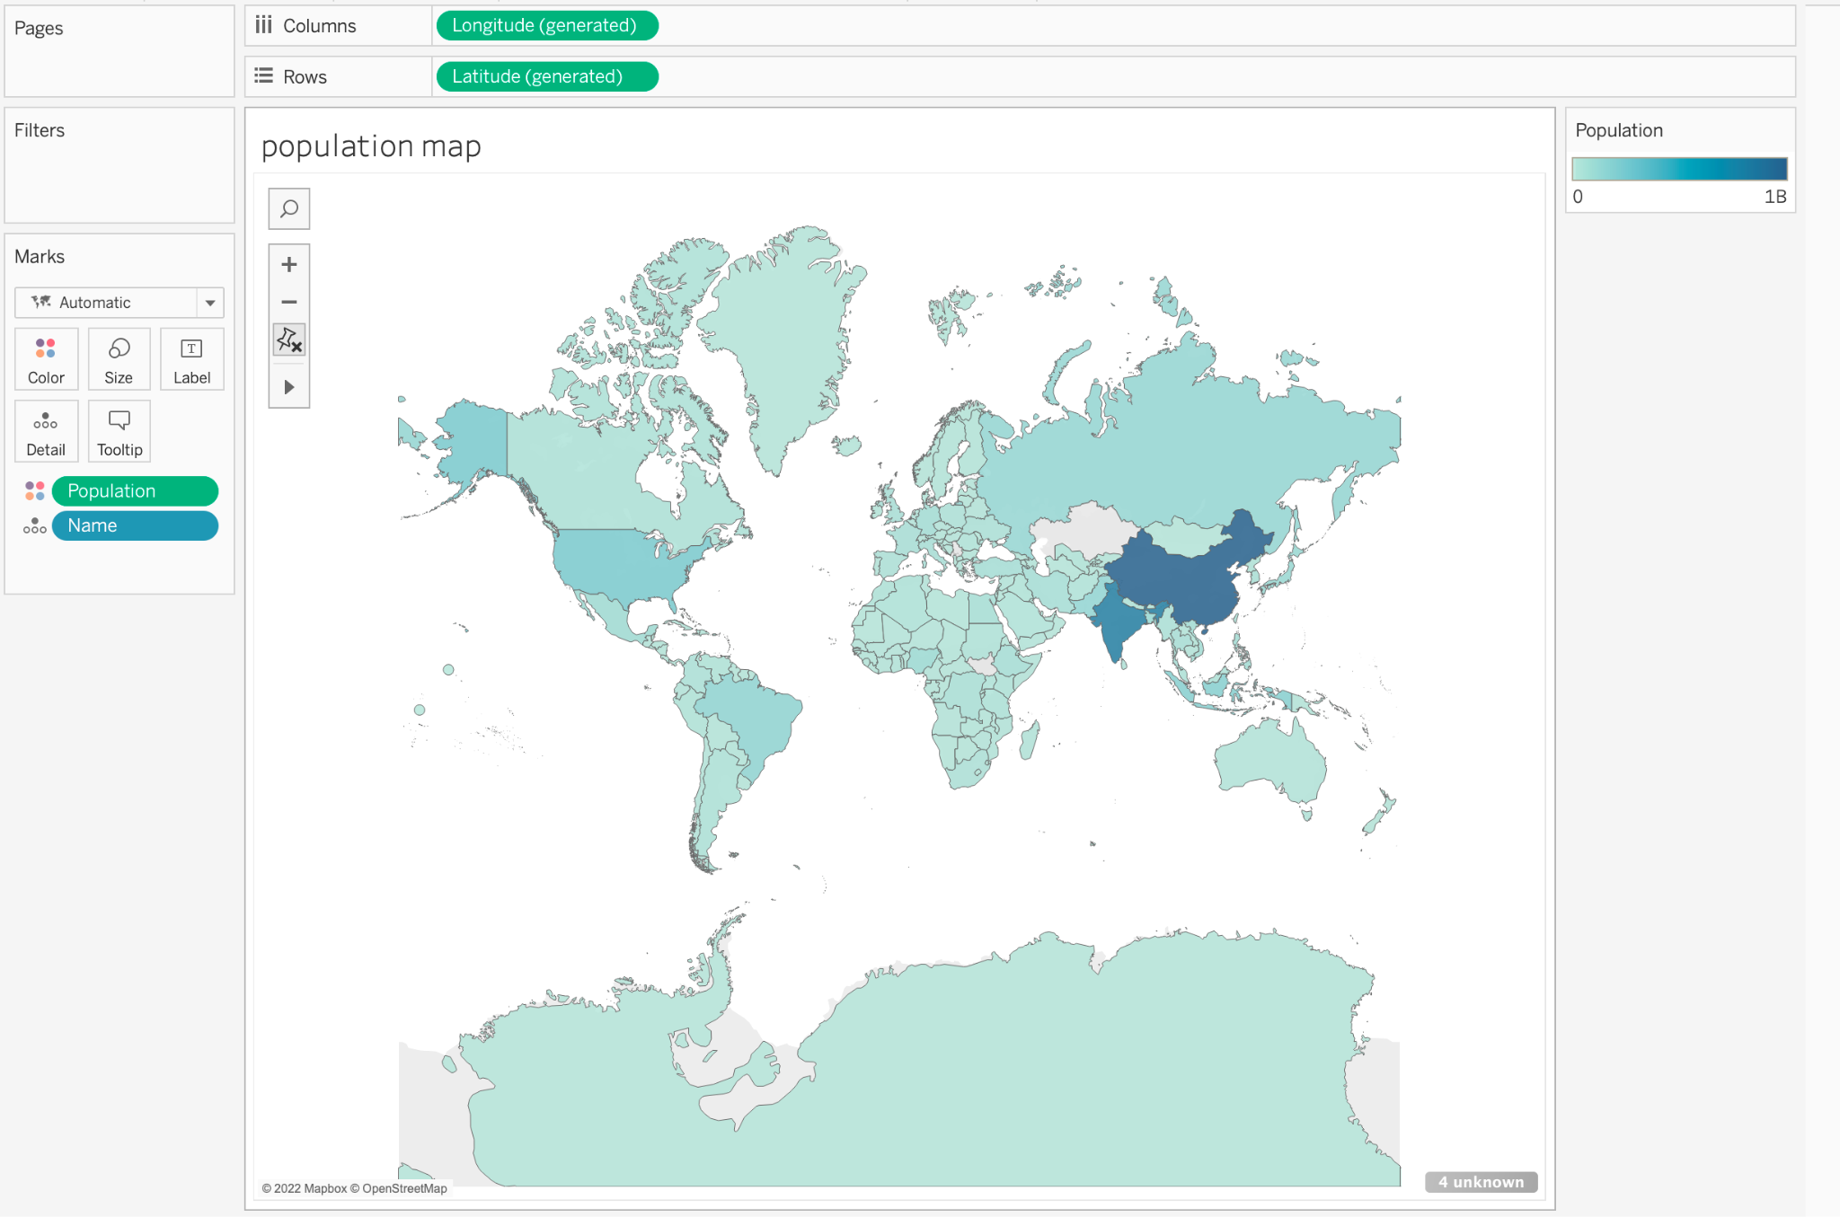
World map of population
Together, we will walk through the process of generating a population map.
Drag:
Longitude to columns.
Latitude to rows.
Population to the marks color panel.
Country name to the detail panel.
Tableau automatically generates a filled map where we have data.
Notes:
The purpose of this slide is to have students create a world population map based on the dataset. WALK THROUGH the process of creating this visualization.

Slide 14
A few gray on that map...
Remember how we found that there was missing population data way back in our first Tableau session?
From this view, we can also see the missing data.
Notes:
The purpose of this slide is to point out how the visualization highlights the missing population data we discovered much earlier in the course.

Slide 15
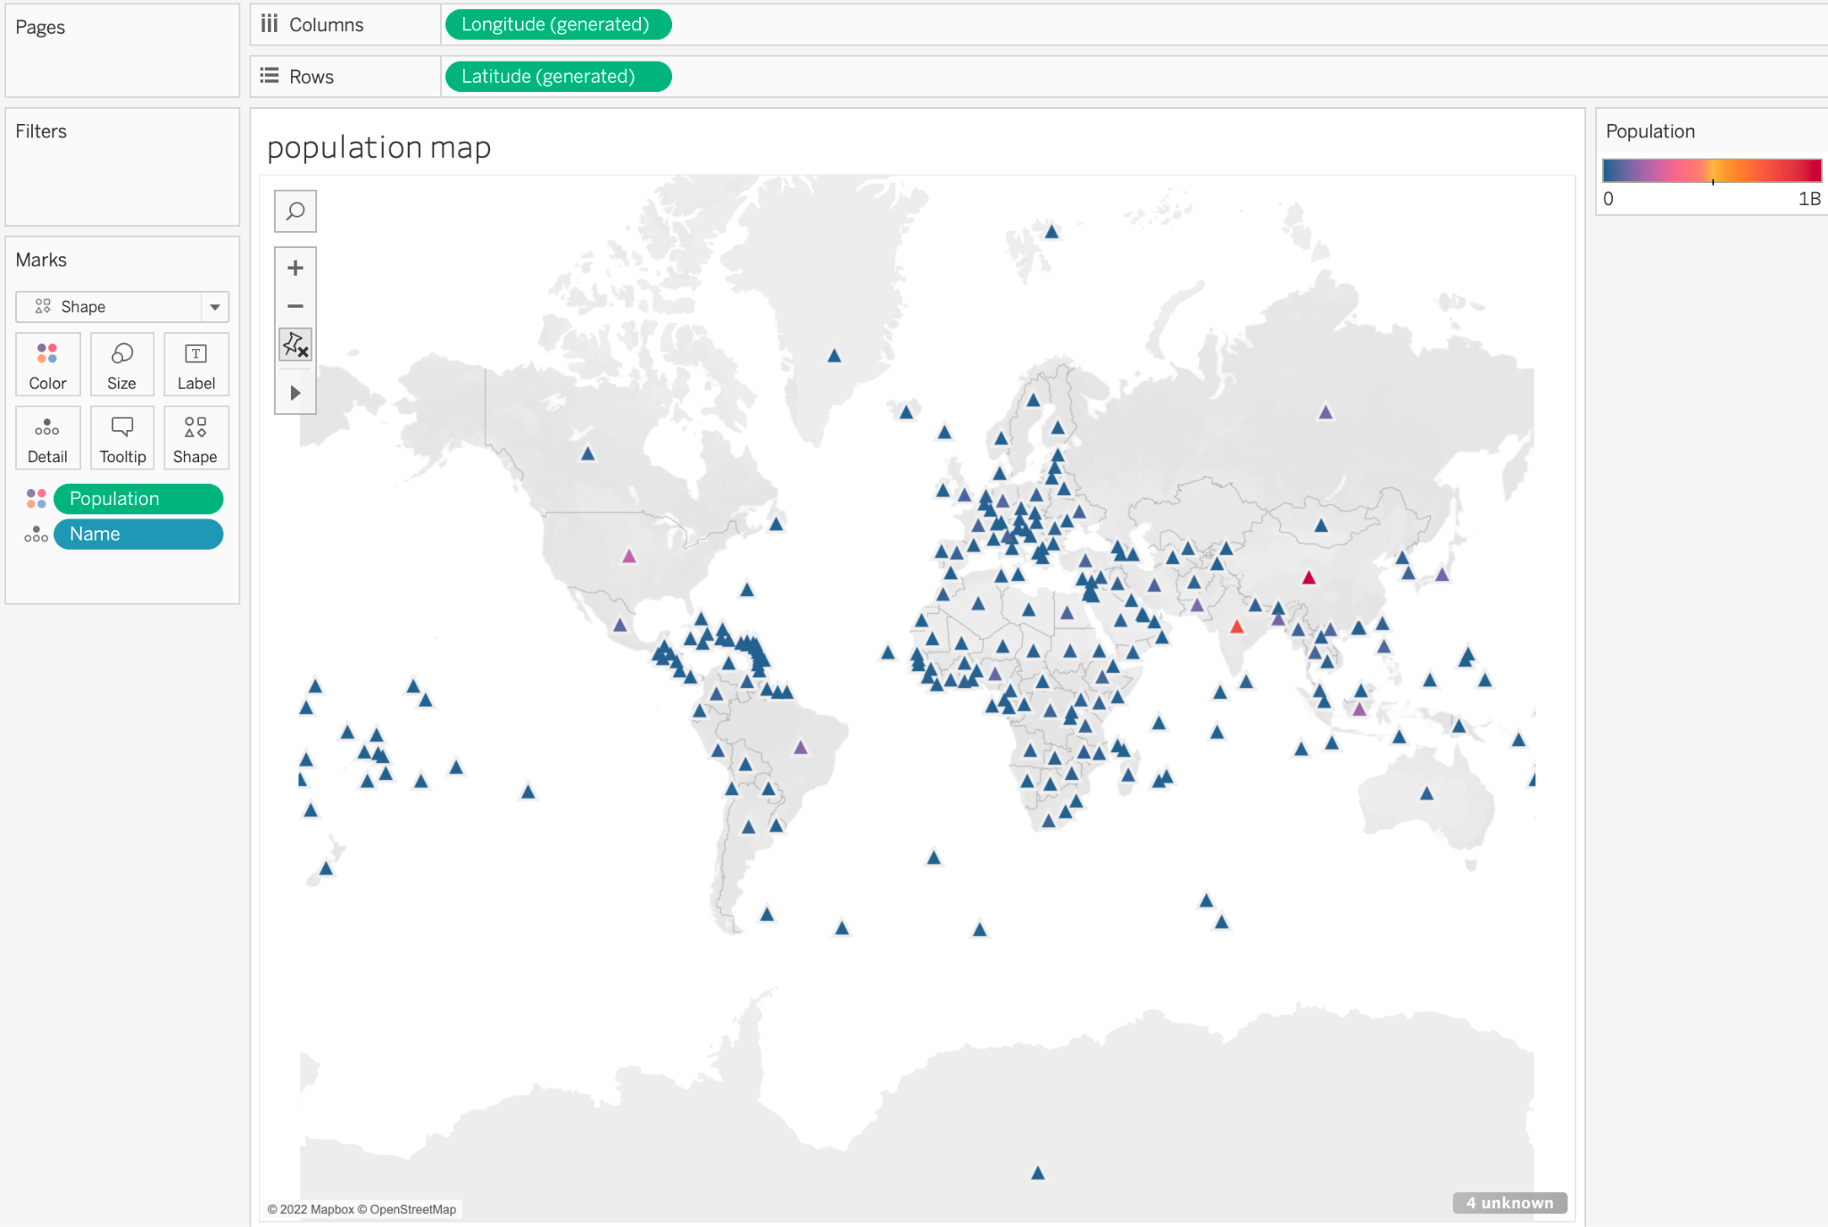
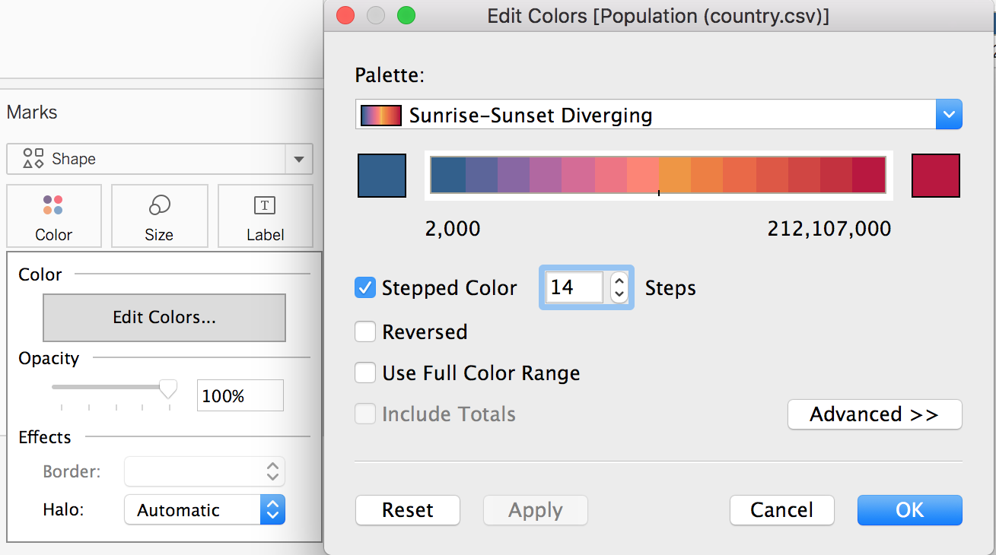
Symbols and filled maps
It is easy to change the look of the map view with the marks dropdowns.
Edit colors on the marks tab to give a more divergent range of colors so that we can distinguish less populous countries.
Notes:
The purpose of this slide is to begin making some changes to the color palette of the map.

Slide 16
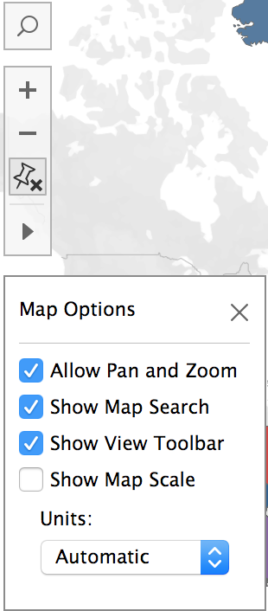
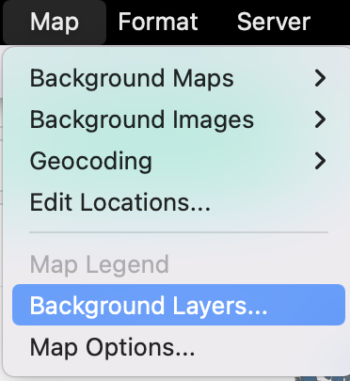
Map control options
Tableau offers map control options like pan, zoom, search, etc.
You have control of these options in the map menu in the top bar.
Notice that pan and zoom are automatically given to you in the view.
Notes:
The purpose of this slide is to point out some of the other options Tableau offers when producing a map visualization.

Slide 17
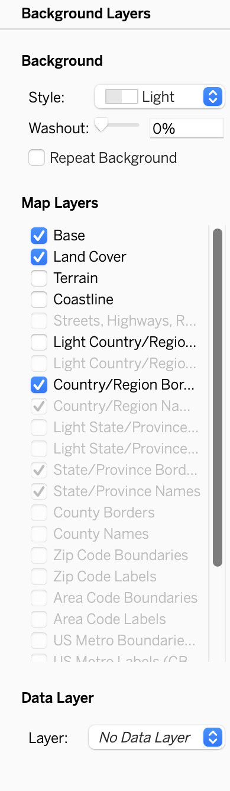
Background layers options: background
The options in the Background Layers submenu let you change the way the map looks.
It can also be used to overlay different maps over each other.
For example, one could look at rainfall map layer over a crop yield map.
For now, try toggling the Background style from the dropdown menu.
Notes:
The purpose of this slide is to point out the options for overlays and background style that exist in the Map Layers submenu. DIRECT students to change the Background style and see how it affects the visualization.

Slide 18
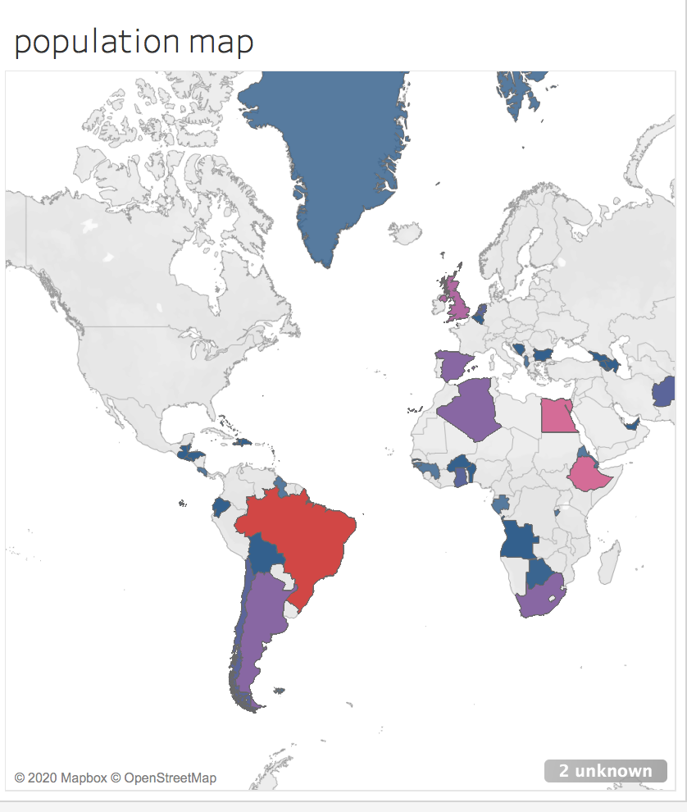
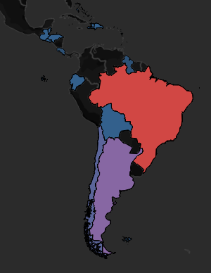

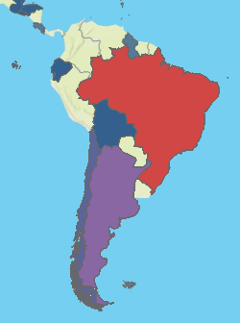
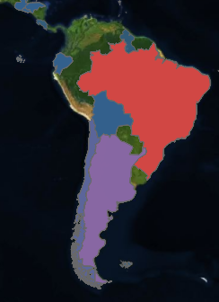


A few possible backgrounds
Notes:
The purpose of this slide is to demonstrate some of the changes to the visualization that occur when manipulating the background. ASK students what impact changing the background has on their perception of the map. COMMENT on their responses.

Slide 19
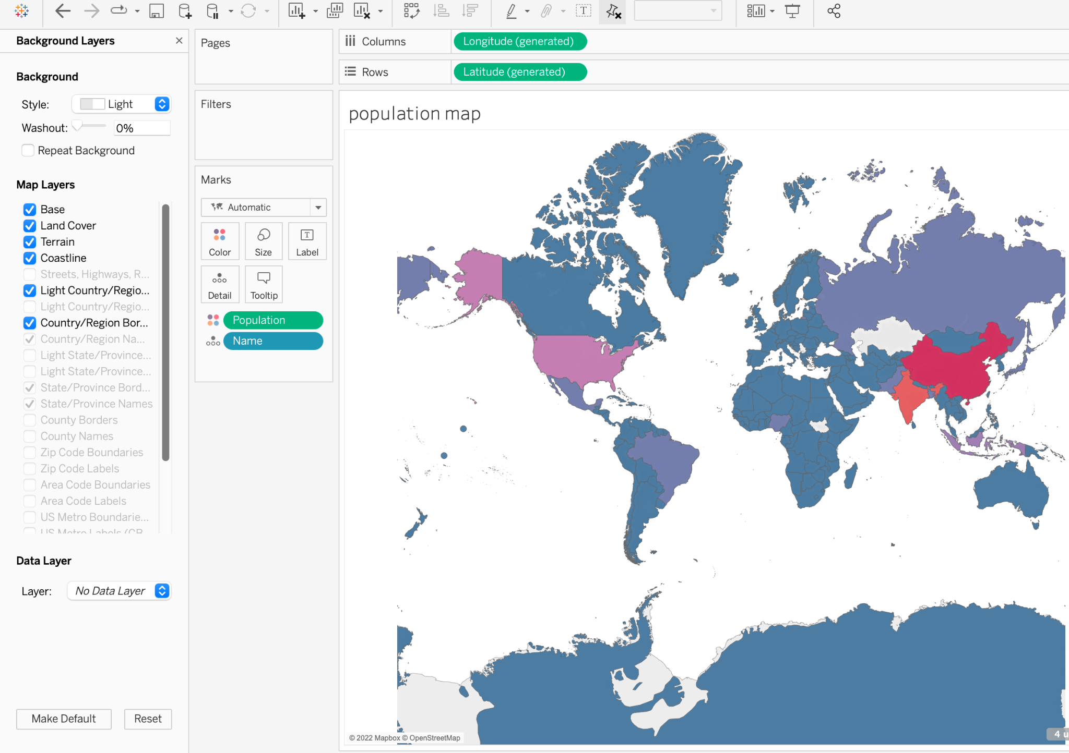
Map layer options: layer checkboxes
The map layers checkboxes allow finer control.
Note: some options are not allowed at this resolution.
Streets and Highways need to be at a higher resolution.
Notes:
The purpose of this slide is to discuss the layer checkboxes that afford Tableau users fine-grained control over layers and visible geospatial data.

Slide 20
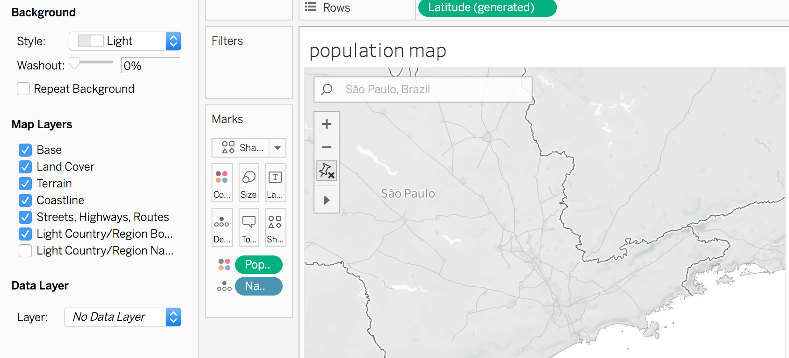
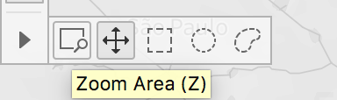
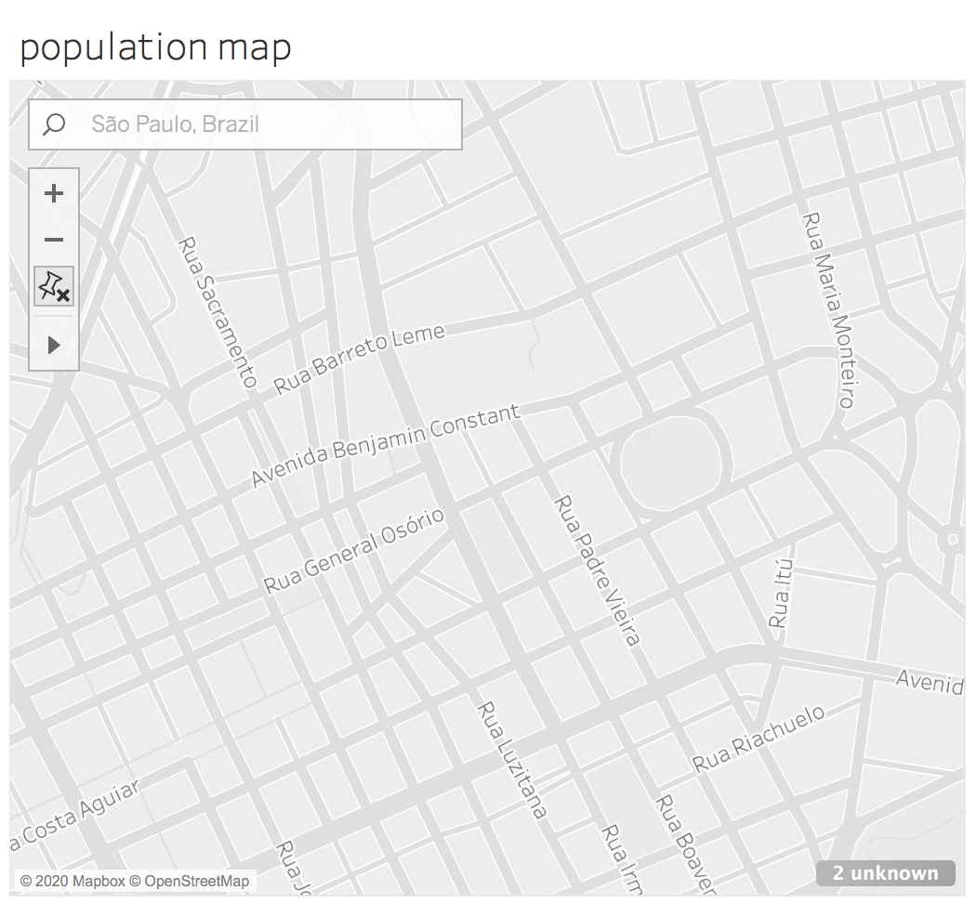
Map layer options: local features
Zoom in to enable local features.
Since Brazil has a high population on this map let’s go to the city level for São Paulo, Brazil.
Note : It is easier to see street details without the population color fill.
Zoom in further to an area that looks interesting, and we can get street level information.
Notes:
The purpose of this slide is to demonstrate how zooming in to an area changes the available layers (based on the granularity of the available data).

Slide 21
Module completion checklist
Objective | Complete
Introduce the concept of geospatial visualization
Implement geospatial visualization for given dataset
Identify and correct errors to facilitate proper joining with geospatial data
Introduce the concept of Dashboards
Combine previously created visualizations into Dashboard

Slide 22
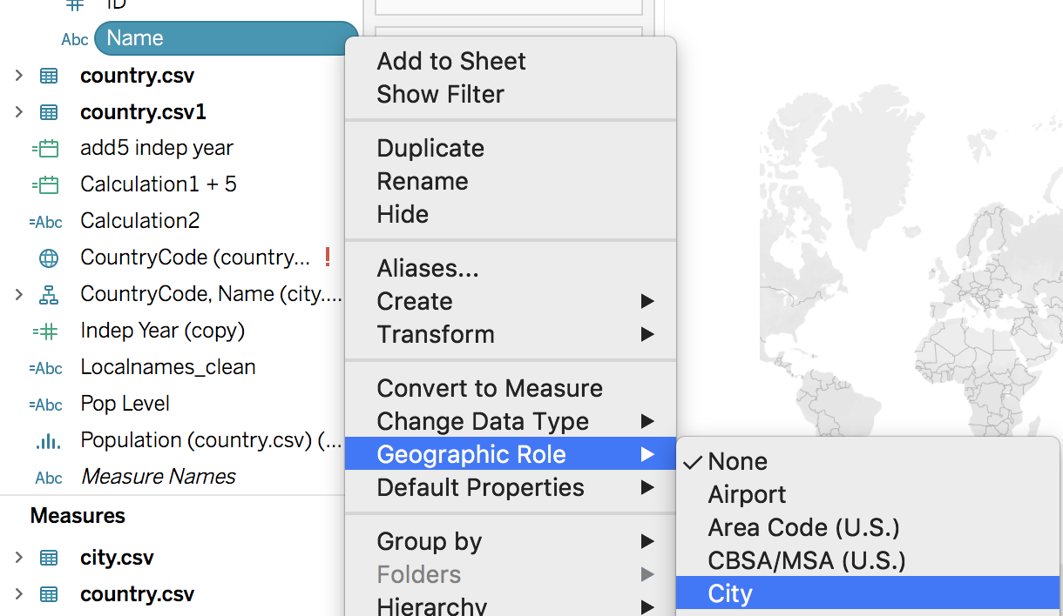
Manually converting to geospatial data
Remember: Tableau didn’t recognize some of our geospatial data, like for “City.”
We can tell because “City” doesn’t have any globe icons.
To fix this, use the dropdown from the pill and tell Tableau which type of geospatial coordinates we have.
In this case we have to tell Tableau that this is “City” data.
Notes:
The purpose of this slide is to how to manually specify a certain data dimension (in this case, City Name) as geospatial data.

Slide 23
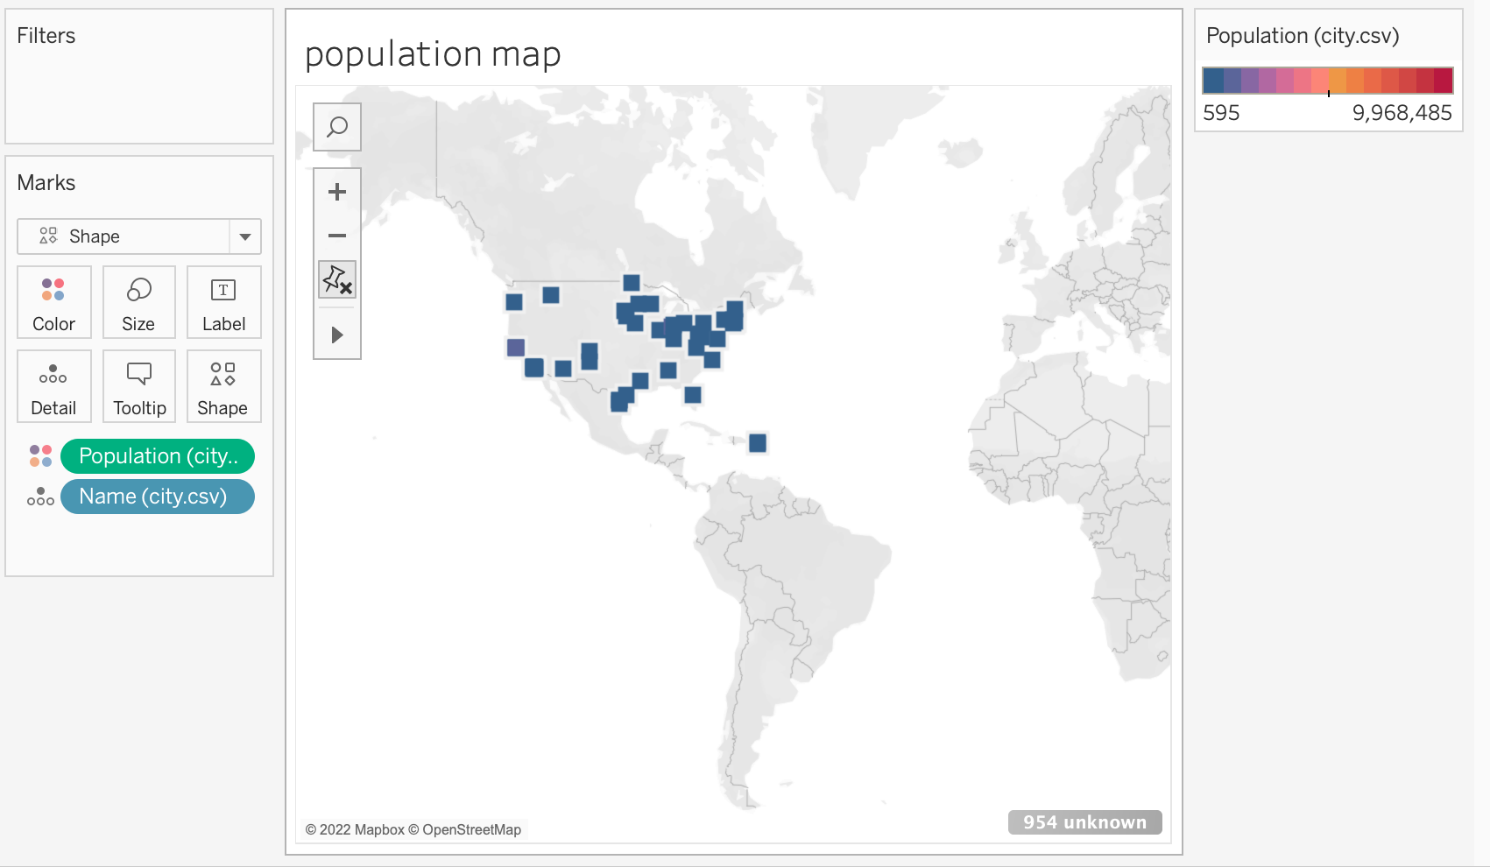
Plot city populations
Now that we have city level coordinates, replace country data with city data in the Marks palette.
What happened when we made that change?
How would you troubleshoot this issue?
Notes:
The purpose of this slide is to modify the visualization to focus on city populations (rather than country populations). WALK THROUGH how to produce the visualization on the slide. ASK students what seems strange or unusual about the resulting visualization and COMMENT on their responses.

Slide 24
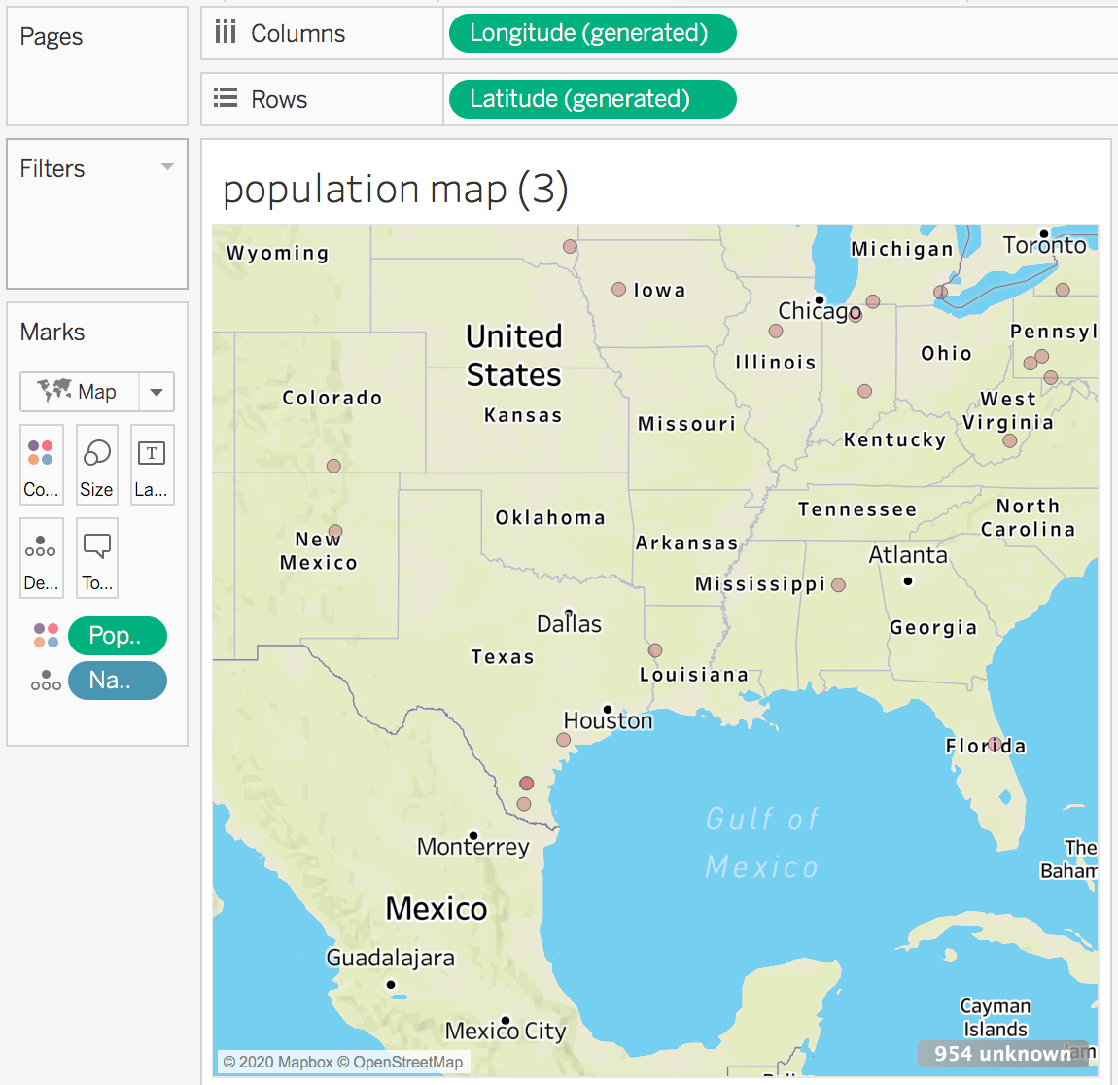
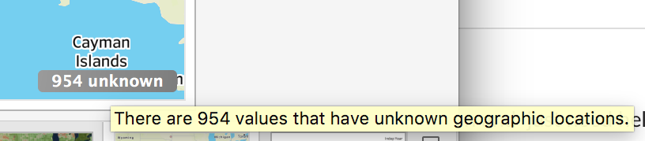
Missing cities
We can see that Tableau has caught 954 cities that it cannot assign a location to.
Click on the “unknown” button on the lower right to troubleshoot and edit the locations.
We could suppress the error message by right clicking it, but in this case that is a bad idea.
Notes:
The purpose of this slide is to show how Tableau users can get more information about missing geospatial data values at a specified level of granularity.

Slide 25
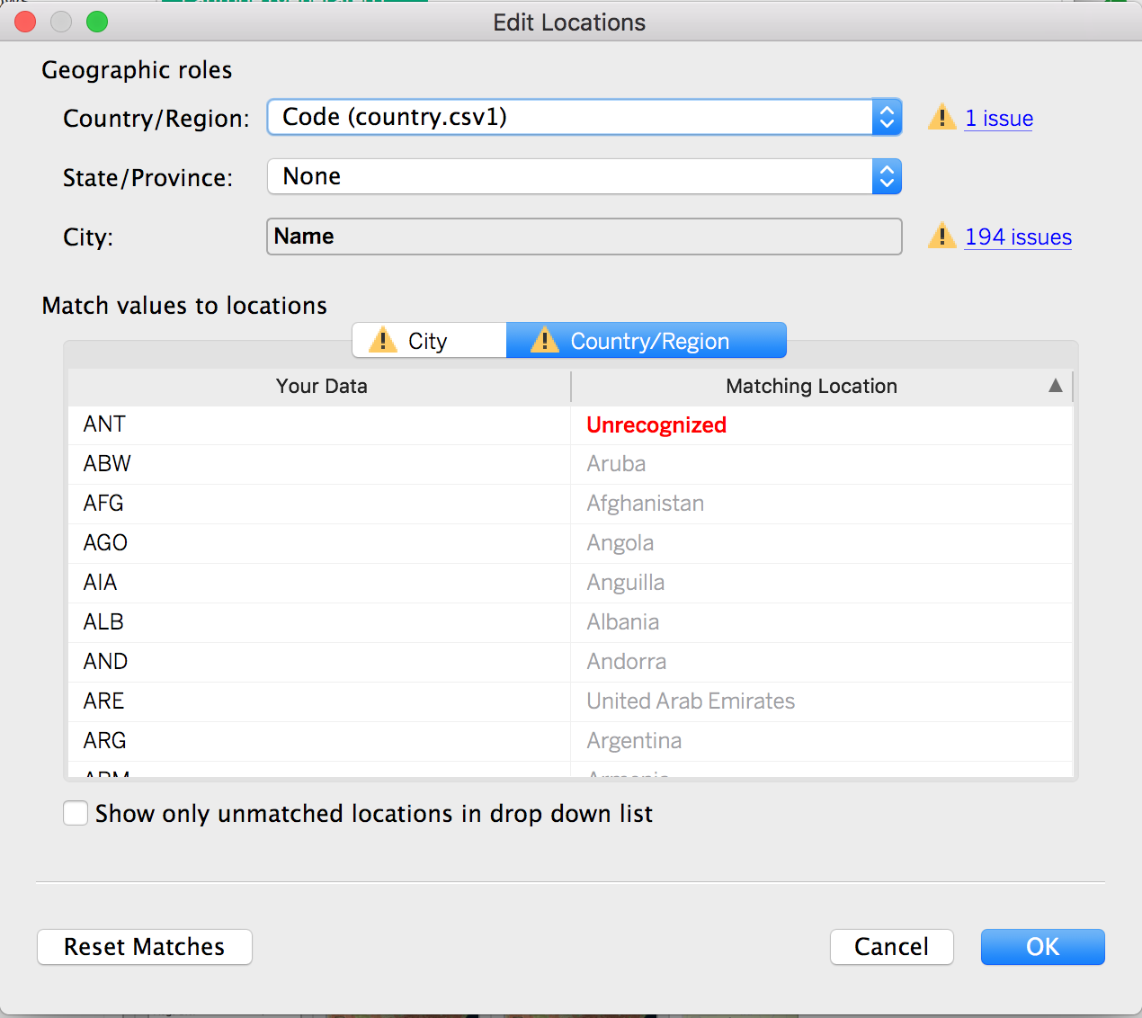
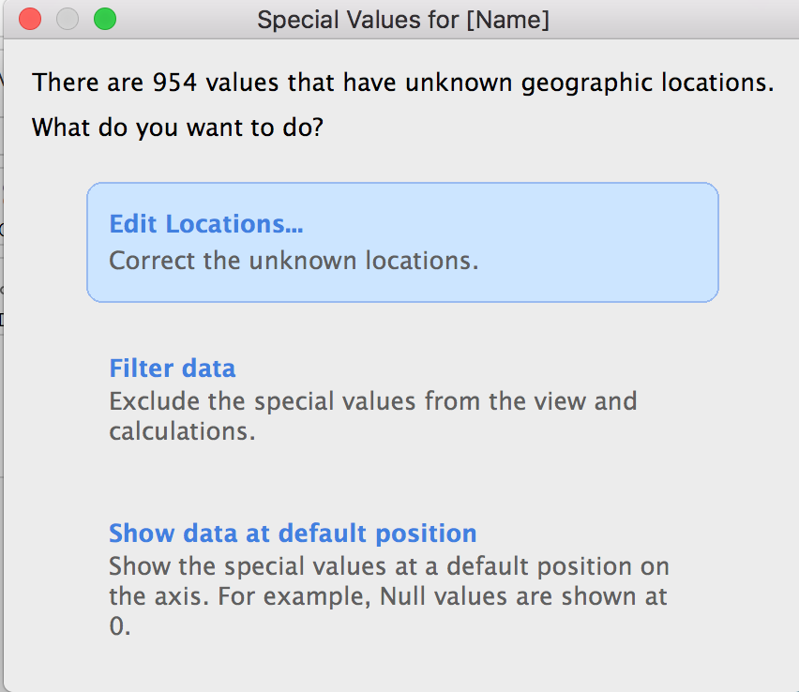
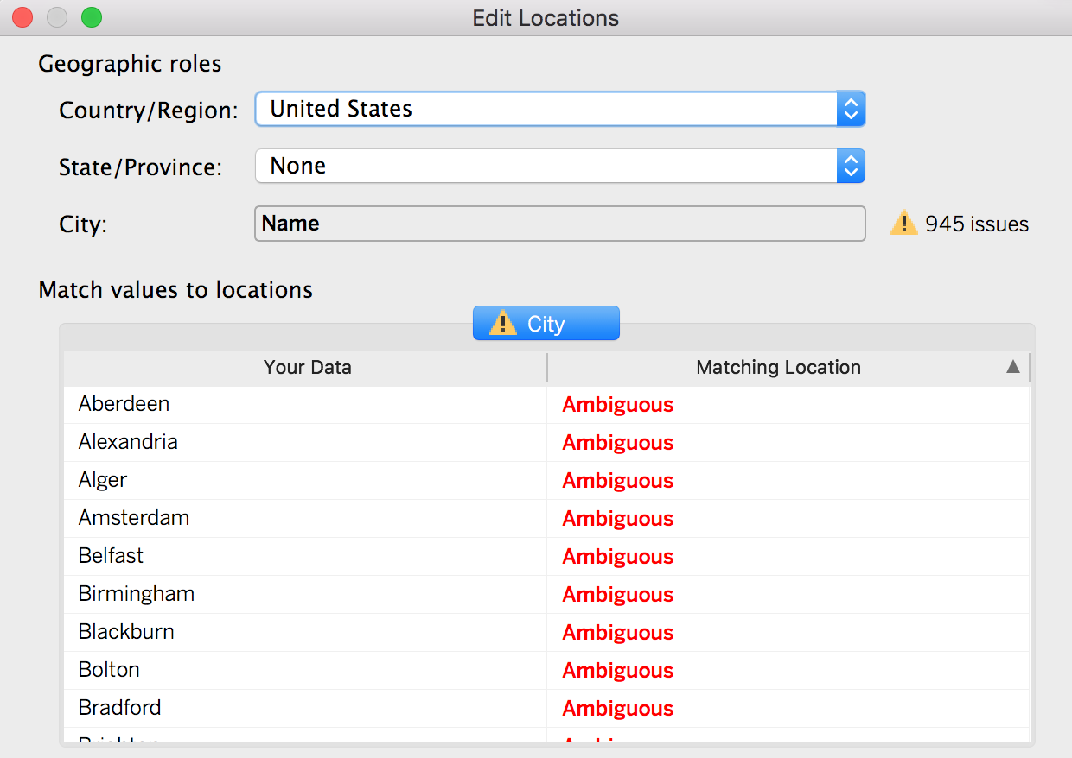
Country assignment issue
When we click on “Edit Locations…,” we can see that the country was limited to the United States.
We want to associate all of these cities with their Country Code, which fixes 757 issues.
Notes:
The purpose of this slide is to discuss how to troubleshoot working with missing geospatial data, first by making sure that the values are associated with the appropriate dataset / level of granularity. WALK THROUGH how to associate the city data with country codes.

Slide 26
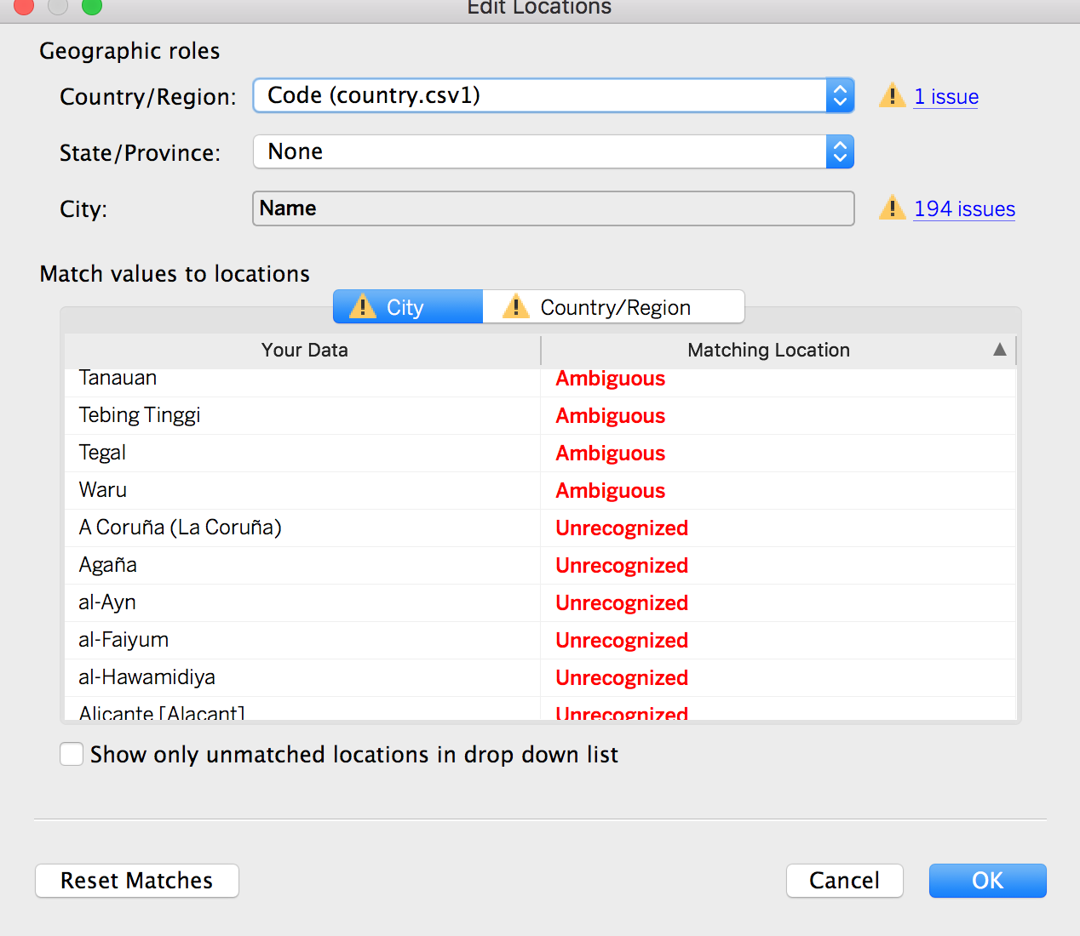
Explore the remaining issues
Look at the cities that are missing.
We see two types of issues:
“Ambiguous”: some cities or counties have the same name but could exist in multiple places.
“Unrecognized”: if there is a location or abbreviation that Tableau does not recognize.
Notes:
The purpose of this slide is to categorize the two remaining issues to be rectified in the city data: Ambiguous and Unrecognized matching locations.

Slide 27
Fix ambiguous issues, if possible
Adding another geographic field, like State/Province, defines the correct location for that data.
If there is a hierarchy in the data pane, Tableau will automatically use the appropriate levels of the hierarchy to solve location ambiguities.
Note: We do not have state/province data, so we will have to leave this out.
Notes:
The purpose of this slide is to outline how to begin fixing ambiguous issues, if possible.

Slide 28
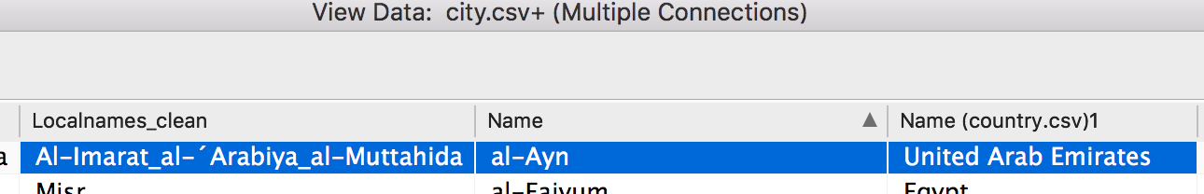
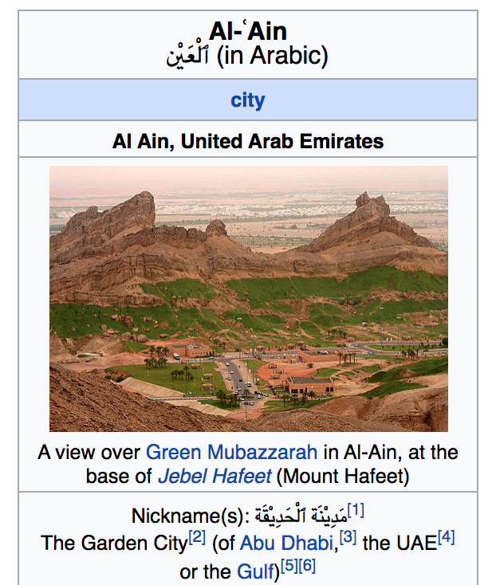
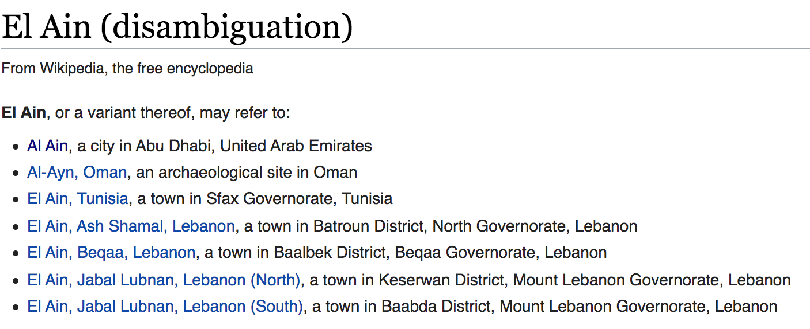
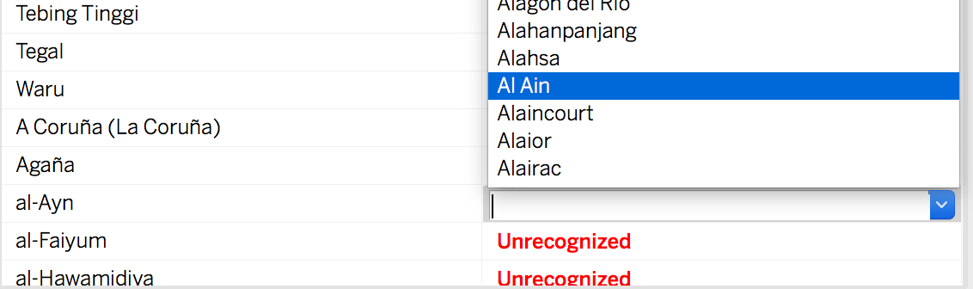
Fix unrecognized issues, if possible
This will take some research.
Many cities may include special characters, or may be entered as an alternate / local spelling.
Go back to the dataframe and find out if there is any other information.
Search Tableau’s database for alternative spellings.
Verify your hypothesis by cross- checking with Google.
Alternatively, enter longitude and latitude coordinates manually if you have them.
Notes:
The purpose of this slide is to outline how to begin fixing unrecognized issues, if possible.

Slide 29
Knowledge check 11

Slide 30
Exercise 11

Slide 31
Module completion checklist
Objective | Complete
Introduce the concept of geospatial visualization
Implement geospatial visualization for given dataset
Identify and correct errors to facilitate proper joining with geospatial data
Introduce the concept of Dashboards
Combine previously created visualizations into Dashboard

Slide 32
End of Part 11

